Slide 1
knet 1.4.x
Cross platform, Light-weight, Multithreading net library

Slide 2
Keywords
Cross-platform
Light weight
Non-blocking
TCP
Multi-threading
Load balance
Cross thread send

Slide 3
Design
loop
balancer
channel & channel reference
timer

Slide 4
balancer & loop
balancer
channel
accept/connect
balance
thread
thread
thread
thread
loop
loop
loop
loop

Slide 5
loop & channel
Accepted channel
try balancing
Connected channel
Accepted channel
from other loop
host
host
Active channels
Closed channels

Slide 6
loop
kloop_t
  The implementation of loop
    epoll
    IOCP
    Select
  Channel lists
    Active channel list
    Closed channel list
  Channel timeout
    Connect timeout
    Idle timeout
  Channel lifecycle
    Channel in closed list and zero reference will be destroyed

Slide 7
channel
Connector
  Always host by the kloop_t which invoke function ‘kloop_create_channel’
Acceptor
  With kloop_balancer_t
    May balanced by kloop_balancer_t to other kloop_t
    Hosted by current kloop_t
  Without kloop_balancer_t
    Always host by the kloop_t which invoke function ‘kloop_create_channel’
Cross thread send
  Send data via the channel which hosted by other kloop_t
  Not a highly efficient way compare to send from hosted kloop_t
Reference
  kchannel_ref_share
  kchannel_ref_leave

Slide 8
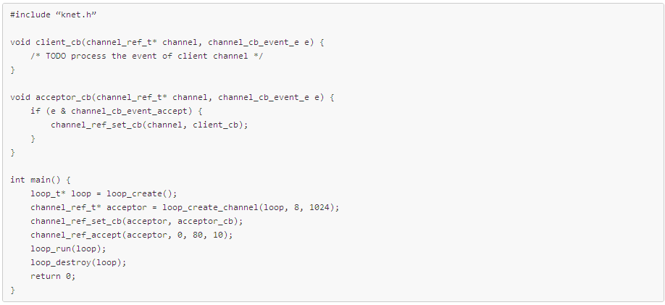
Sample – Acceptor

Slide 9
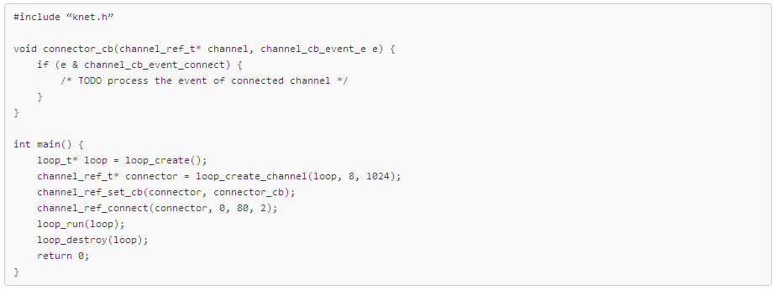
Sample - Connector

Slide 10
Channel event
channel_cb_event_connect
  Connect to remote host successfully
channel_cb_event_accept
  Accept a new client successfully
channel_cb_event_recv
  Received from peer
channel_cb_event_send
  Sent to peer
channel_cb_event_close
  Channel closed
channel_cb_event_timeout
  Channel idle timeout
channel_cb_event_connect_timeout
  Connect to remote host timeout

Slide 11
Channel reference
kchannel_ref_share
  Increase the reference count of kchannel_ref_t
  Call the method when you hold kchanne_ref_t out of hosted kloop_t
kchannel_ref_leave
  Decrease the reference count of kchannel_ref_t
  Call the method when you don’t need this channel in current thread
kchannel_ref_t can be destroyed when reference count reach to zero
kchannel_ref_close
  Close channel and switch channel from active channel list to closed channel list
  kloop_t iterate closed list periodically and destroy zero-reference channel

Slide 12
balancer
The mediator of loops’ balance
Dynamic load balancing
  Balance according to active channel count
Thread safety
  Attach
  Detach

Slide 13
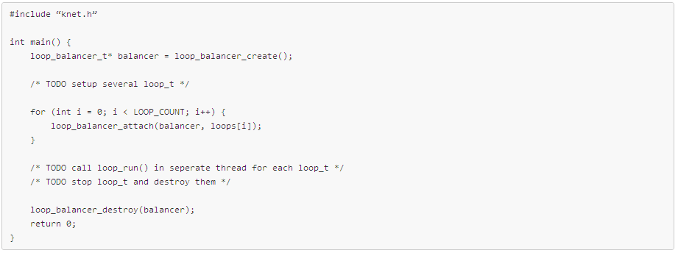
Sample - Balancer

Slide 14
Thanks
https://github.com/dennis-kk/knet

